Slide 1


SAP UI5 & FIORI with OData TRAINING using BAS
Sakshi Gupta
Day – 2

Slide 2

Agenda – Day 2
Introduction to CSS
Inline style CSS
Internal style CSS
Concept of Box Model in CSS
Concept of Pseudo Classes in CSS
External style CSS
What is JavaScript?
Basic usage of JavaScript
Important Points about JavaScript
Variables and Data Types
Arrays and Objects in JS
How to Apply JS to HTML Page
Inline and Internal JS
Changing CSS at runtime
Adding Dynamic Content
Debugging
Synchronous and Asynchronous Response
External JS

Slide 3

Introduction to CSS
CSS Stands for Cascading Style Sheets, it is used to format/beautify the HTML content.
CSS describes how HTML elements are to be displayed on screen.
CSS saves a lot of work. It can control the layout of multiple web pages all at once.
We need CSS because HTML can only generate static content w/o coloring, formatting, borders, beautification.
Before css we have to use HTML tags for formatting which was very cumbersome
<p>I <b><color value=“red”>love</color></b><font val=“Calibri”>India<font></p>
There are 3 ways we can apply CSS on HTML Content
Inline CSS – applied at each element level <tagname style=“prop:val;prop:val;..”>….
Internal CSS – applied at the page level to target one or more than one html elements on the page. It is fully reusable.
External CSS – Where the CSS is applied by putting code in a reusable css file and later use the link tag to connect the same.

Slide 4
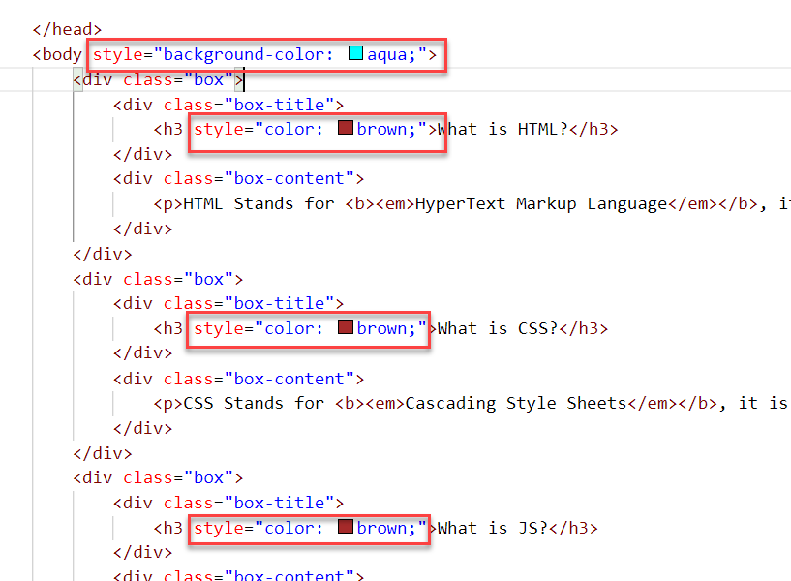
Inline CSS
Inline CSS is used to style a specific HTML element.
To apply Inline CSS add a style attribute to each HTML tag.
Inline styles in CSS could be useful for previewing changes instantly.
It can be useful when adding CSS rules to only one or two elements.
Syntax to apply Inline style CSS
<htmltag style="cssproperty1:value; cssproperty2:value;"> </htmltag>
We can see all the available CSS properties on the W3C:
https://www.w3schools.com/css/default.asp
Disadvantages of using Inline style CSS:
These styles cannot be reused anywhere else.
Adding CSS using this technique is time-consuming.
These styles are tough to be edited because they are not stored at a single place.

Slide 5
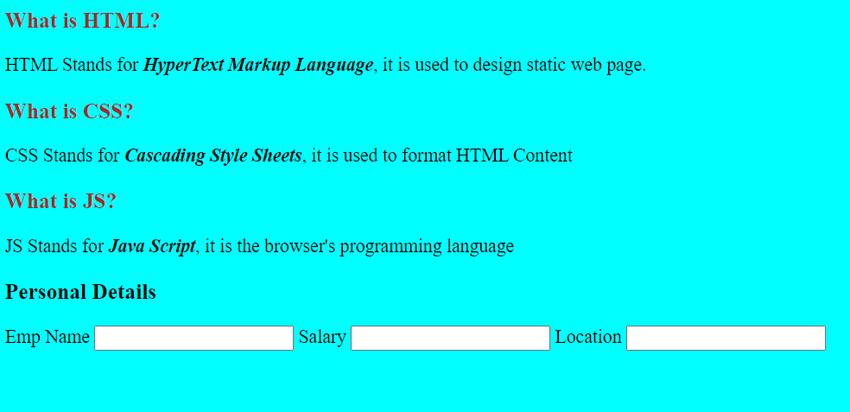
Hands – on: Inline CSS
Apply basic style to our html page using the Inline CSS technique.
For this exercise we will create a new file named cssbasics.html in our current folder.
Code Link:
cssbasics.html

Slide 6
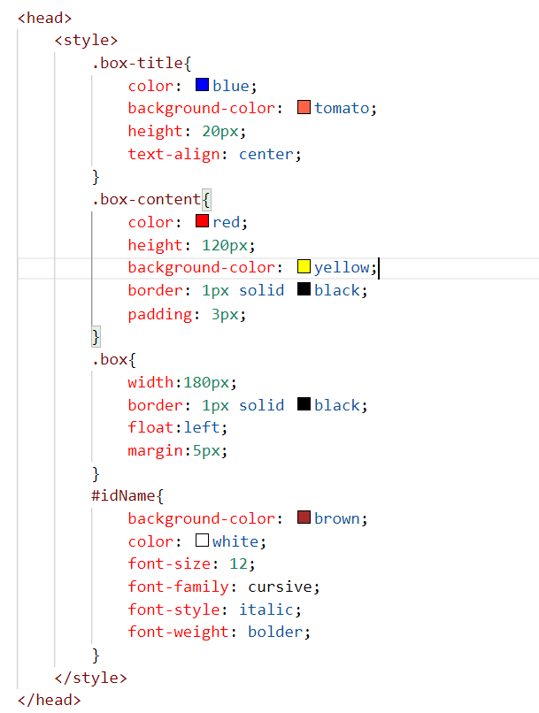
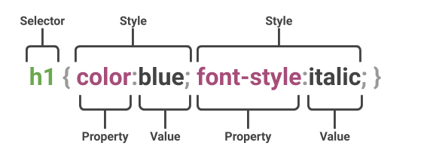
Internal CSS
The internal style sheet is used to add a unique style for a single document. It is defined in <head> section of the HTML page inside the <style> tag.
This CSS style is an effective way to style single pages.
Internal CSS is applied using the Selectors in the HTML page, which makes the styling easy.
Syntax to apply the Internal style CSS
<style>
selector{
propertyname: value;
propertyname: value;
}
</style>
Selector: CSS selectors are used to "find" (or select) the HTML elements you want to style.
The are three type of selectors in CSS.
#id: Id of the single element
.classname: group of elements which has same classification property
Tagname: group of elements which has same tag name

Slide 7
Box Model in CSS
In CSS, the term "box model" is used when talking about design and layout.
All HTML elements can be considered as boxes.
The CSS box model is essentially a box that wraps around every HTML element. It consists of: margins, borders, padding, and the actual content. The image below illustrates the box model:
margin
border
border
padding
Html element
Html element

Slide 8
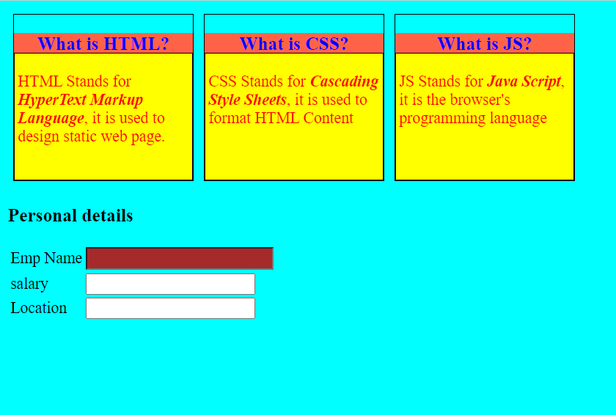
Hands – on: Internal CSS
Now will apply the CSS using the Internal style CSS to our block level elements (box and box-content), will also see how to use different types of selectors for styling the content.
We will also see some commonly used properties of CSS.
Code Links:
cssbasics.html

Slide 9
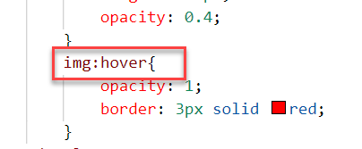
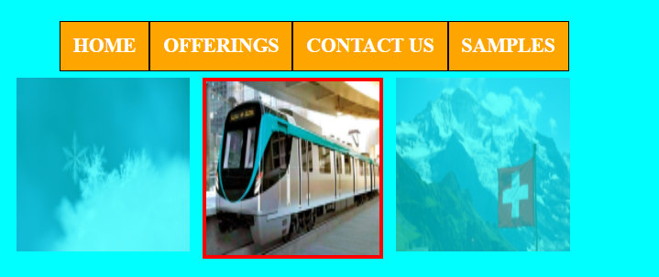
Pseudo-classes in CSS
A pseudo class is used to apply effects on the control based on special conditions or activity.
For example, it can be used to:
Style an element when a user mouses over it
Style visited and unvisited links differently
Style an element when it gets focus
Syntax to use pseudo class
selector:pseudo-class { property: value; }

Slide 10
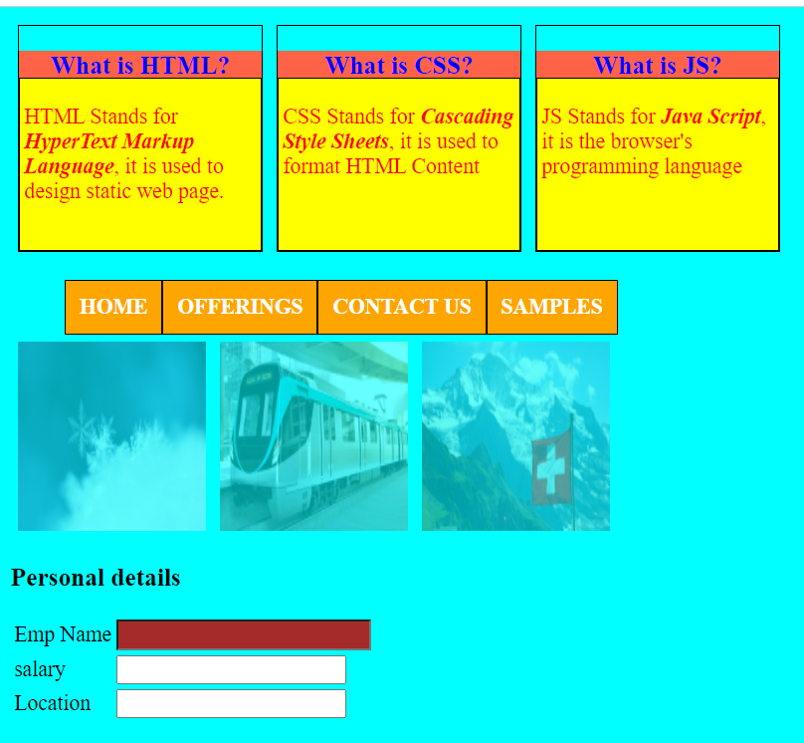
Hands – on: Pseudo Classes in CSS
Add three images and style them using the hover class of CSS. So when we hover the mouse on the image gets highlighted.
Also create a Navbar in our HTML Page.
In this exercise we will also see how to apply styling on the child elements using the parent element..
Code Links:
cssbasics.html

Slide 11
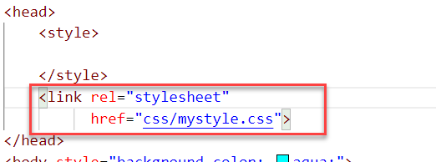
External CSS
In external CSS, we link the web pages to the external .css file.
This CSS type is a more efficient method, especially for styling a large website. By editing one .css file, you can change your entire site at once.
Since the CSS code is in a separate document, your HTML files will have a cleaner structure and are smaller in size.
An external style sheet can be linked to an HTML document using the <link> tag. The <link> tag goes inside the <head> section.

Slide 12
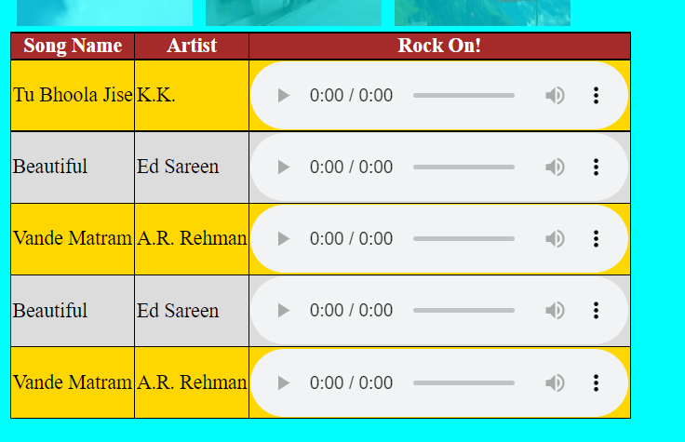
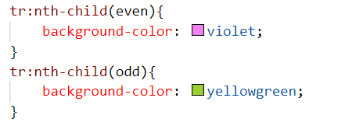
Hands – on: External CSS
Now we will use the External style CSS to style our HTML page.
We will also style our table element to demonstrate the concept of styling the child elements.
Exercise code:
cssbasics.html
mystyle.css

Slide 13
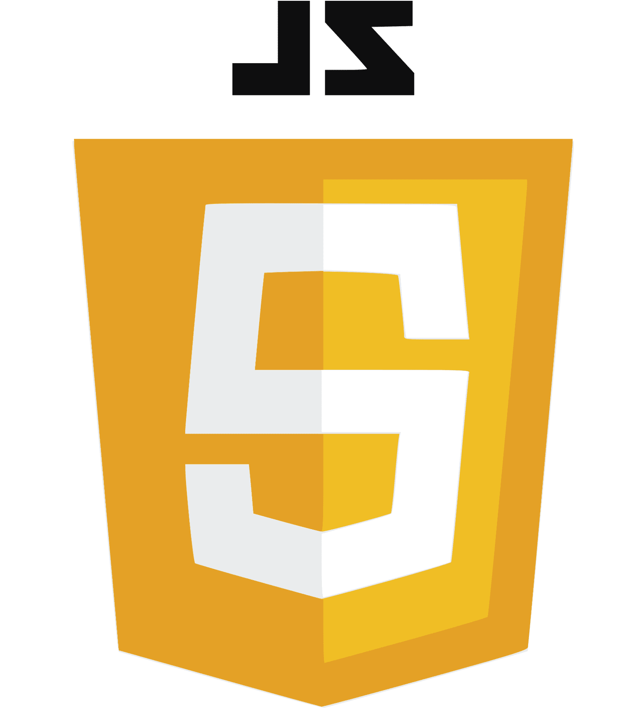
What is JavaScript?
JavaScript is the Programming Language for the Web. Simply, JavaScript is browser’s programming language.
Every browser directly understand JavaScript.
Java and Java Script are completely different in their design, purpose and usage.
JavaScript is the world's most popular programming language.
JavaScript is among the most powerful and flexible programming languages of the web. It powers the dynamic behavior on most websites.
There are two types of JavaScript:
Client-Side JS
Server-Side JS
Client-Side JS:
When the JS code runs on the client side (browser), then it is known as Client-side JS.
It is simple, easy and used in web development.
Since the code runs on client side, it is extremely fast and we can test/debug it directly in browser.
Server-side JS:
When the JS code runs on the server side, then it is known as Server Side JS.
This gives a benefit to developer to learn only one language with which they can code on both side.
Server side JS can be used to validate data, db look ups, send mails, trigger integration.
NodeJS is one of the example of Server Side JS. (It is a framework developed to work on server side).

Slide 14
Basic Usage of JavaScript
JS can used to show output to user.
It is used to Validate user input.
We can change the CSS at runtime using the JavaScript.
Manipulate the DOM
Access the HTML Elements and their properties/values
Send call to server
Develop Application logic
To display dialog boxes and pop-up windows.

Slide 15
Some Important Point related to JavaScript
JavaScript is case-sensitive. E.g value and Value are not same (80% developers does case-sensitive errors)
Every statement in JS ends with semi-column (;).
The variable names and function names follow camel-case naming convention which means first letter of first word is small and next consecutive word’s first letter is caps.
Ex:-
iloveindia ➔ iLoveIndia
wearelearningJS ➔ weAreLearningJs
We can declare variable in JS without specifying any data type, based on the value assigned the data type is automatically picked, the keyword to declare variable is var.
Java script unlike other programming language is a asynchronous non-blocking i/o.
JS offers 2 built-in objects
document – the object of DOM, using this object we can access HTML elements of our page.
window – it is the object of browser window
Symbols will have special meaning
( ) - parenthesis
{ } - braces
[ ] – bracket
In JS = is an assignment operator, == and === are comparison operator, == compare only value and === compare data type and value both.
We can run JS on Console. To open Console press F12 on the browser window.

Slide 16
Variables and Data Types
Variables: Variables are containers for storing data (storing data values).
Data Types: Data types in JavaScript describe the different types or kinds of data that you will be working with and storing in variables.
JavaScript Data Types
Primitive
Non-Primitive/Reference
String
Array
Object
Number
Boolean
Undefined
Null
Symbol

Slide 17
Arrays and Objects in JS
Array
An Array is a collection of data and a data structure that is stored in a sequence of memory locations.
One can access the elements of an array by calling the index number such as 0, 1, 2, 3, …, etc.
Index in an array always starts with ‘0’ (zero).
The array can store data types like Integer, Float, String, and Boolean all the primitive data types can be stored in an array.
Syntax to define an array
var arrName = [item0, item1,….];
Object
An Object is a non-primitive, structured data type in JavaScript.
Objects are same as variables in JavaScript, the only difference is that an object holds multiple values in terms of properties and methods.
Syntax to define an Object
var oObjName = { “prop”: value,
“prop”: value,
“prop”: value }
Note:
JSON stands for Java Script Object Notation.
We can validate JSON over jsonlint https://jsonlint.com
Ex:
var myArr = [1, 2, 3, 4, 5];
var myArr2 = [‘a’, ‘b’, ‘c’];
Example of an Object
{
"empStructure": {
"empNo": 100,
"empName": "Latika Roongta",
"salary": 9000,
"currency": "EUR"
}
}
Entity set
Elements or properties

Slide 18

Hands – on: JS Basics
Understand some basic coding of JavaScript in the browser Console.
Code link:
JSBasics

Slide 19
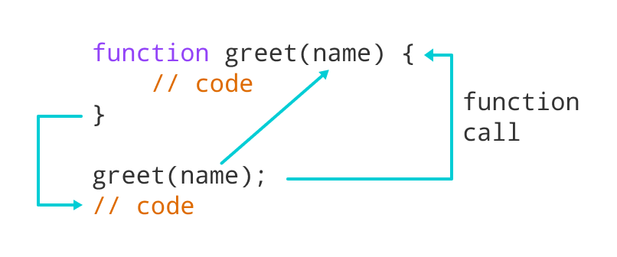
Function in JavaScript
Functions in JavaScript
A JavaScript function is a block of code designed to perform a particular task.
A JavaScript function is executed when "something" invokes it (calls it).
A JavaScript function is defined with the function keyword, followed by a name, followed by parentheses ().
The code to be executed, by the function, is placed inside curly brackets: {}
Function parameters are listed inside the parentheses () in the function definition.
Function arguments are the values received by the function when it is invoked.
Inside the function, the arguments (the parameters) behave as local variables.
Types of functions
Functions are of 2 types →
1. Anonymous function 2. Named Function
function(params) {
//code
}
function functionName(params) {
//code
}

Slide 20
How to Apply JavaScript
JavaScript can be applied to an HTML Page in three ways
Inline JS – The script code is applied at html element level using events e.g., onclick, ondblclick, onhover, onkeypress. This is not recommended as its not reusable.
Internal JS – We write script code inside a script tag. We can use functions for that. There are 2 types of function. Which means it is reusable.
External JS – JS code is written in another file which has extension as .js. We will link it with our script tag. In the same way we linked CSS with link tag.
List of JavaScript Events:
https://www.w3schools.com/jsref/dom_obj_event.asp
document: document is the object of DOM, it is used to access the DOM elements easily. It’ll provide ready to use API (functions) which are built in to access objects of DOM elements (html element).
getElementsByClassName
getElementsByTagName
getElementById

Slide 21
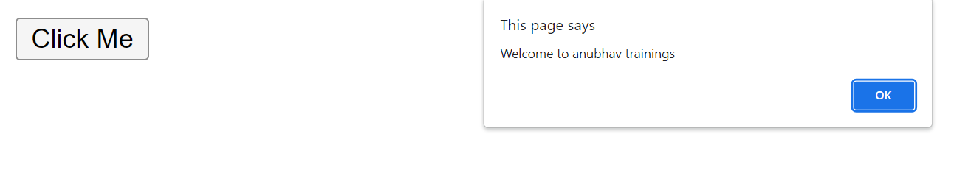
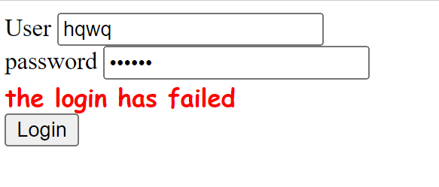
Hands – on: Inline and Internal JS
Now will apply JavaScript to our HTML page using the Inline and Internal method.
For this exercise we will create a new file named JSBasics.html in our current folder.
Part 1: Inline JS
We will create a button in the HTML page using the <button> tag and on press of that button we will show an alert message to the user.
Code Link:
JSBasics.html
Part 2: Internal JS
We will create to a form using the <label> and <input> tag in the page. It will have a username and password field. When the user enter the same value in both of the field and press the login button show success to the user else show error.
Code Link:
JSBasics.html

Slide 22
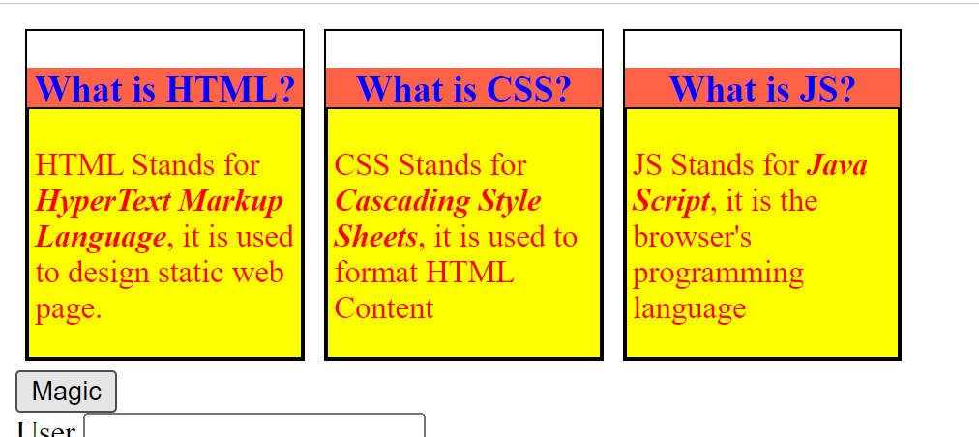
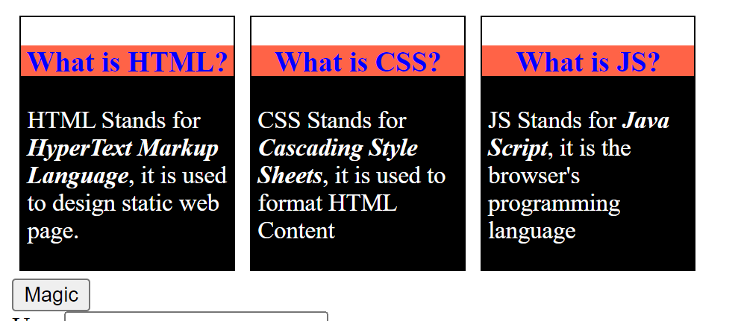
Hands – on: Changing the CSS at runtime
Now we will change the style properties of the elements in the HTML page at the runtime.
For this we will add a Magic Button on the page, on press of that we will change the color of the box-content.
Code Link:
JSBascis.html

Slide 23
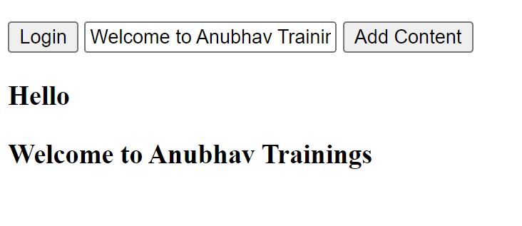
Hands – on: Adding Dynamic Content
Now we will see how to add content dynamically to our HTML page at runtime.
For this we will add a new input field and a button to the page and on press of the button whatever is written in the input field will be printed on the page.
Code Link:
JSBasics.html

Slide 24
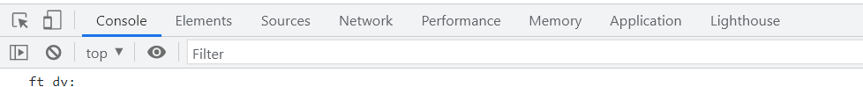
Debugging
Debugging is the process of detecting and removing of existing and potential errors (also called as 'bugs') in a software code that can cause it to behave unexpectedly or crash.
In order to debug our code, press F12 in browser window and go to the Source tab. In source tab set up the Break point by clicking on the line number.
Shortcuts for debugging are shown below:
Type | ABAP | JS
Step-in | F5 | F11
Step-out | F7 | Shift+F11
Go to next | F6 | F10
Continue (till Next BP) | F8 | F8
There are several tabs in the console, while working on the application we are mainly focused on Console, Elements, Source and Network Tab.
Console: It is the place where we run the JavaScript Code and Print the output for testing and Debugging
Elements: It shows the DOM of the current page open in browser.
Source: All the JavaScript code of the app or page will be visible here. We can also debug the code form here.
Network: We can see all the Network related calls made by the application in this section.

Slide 25
Synchronous and Asynchronous Response
User
Screen
Server
Database
Save
Processing
Time
Request send to server
Request to Database
Synchronous Response
For all this time user
Remains blocked
Response form Database
Save
Request send to server
For all this time user
Remains blocked
Request to Database
Asynchronous Response
For all this time user
Is Not Blocked
Response from the server
Response form Database
Callback

Slide 26
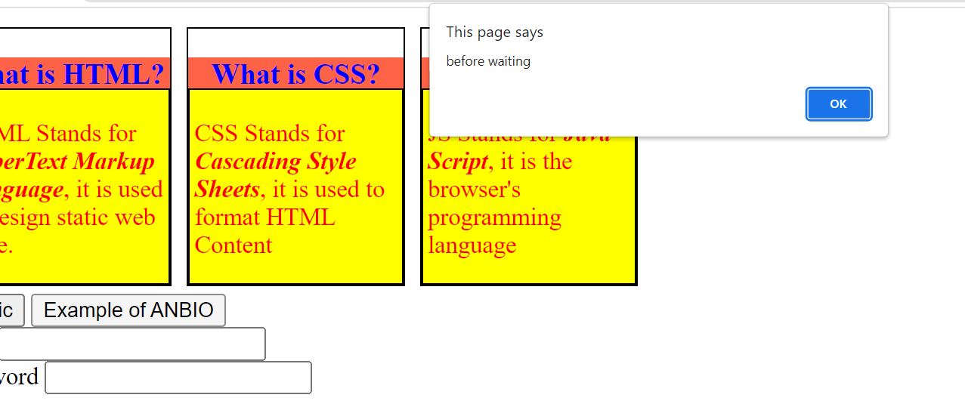
Hands – on: Async Behavior of JS
Now we will see how JavaScript works asynchronously.
We will also see how to use the Callback function in JS.
Code Link:
JSBasics.html

Slide 27
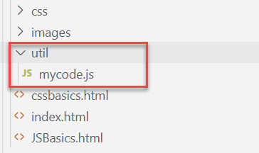
Hands – on: External JS
Create a new utils folder in the current webapp folder and in that utils folder create a new mycode.js file.
Move all the code written in the <script> tag to the new mycode.js file.
Code Link:
JSBasics.html
mycode.js

Slide 28

End of Day 2

Slide 29

Questions

Slide 30

Sakshi Gupta

Slide 31


We’re committed to empower you to be
Most Desirable Resource
through powerful training solutions.
We build the workforce of the future.
250+
Corporate Clients
30,000+
Learners Trained
25000+
Learners Placed
FREE WEBINARS
Sign up for free webinars with industry experts every fortnight!
Enroll Now!
Contact us today!
https://anubhavtrainings.com/

Slide 32




More from AnubhavTrainings.com

Slide 33
Title
Content

